Slide 1


HEP Weekly Report
George Bakas
NTUA

Slide 2
Progress Report
DCS
Redundancy task
Managed to configure the task.. Test it in production
HGCAL
Improvements and development of the component
ArdEnvino
Set up RD51 SloCSy
Environmental variables are up

Slide 3
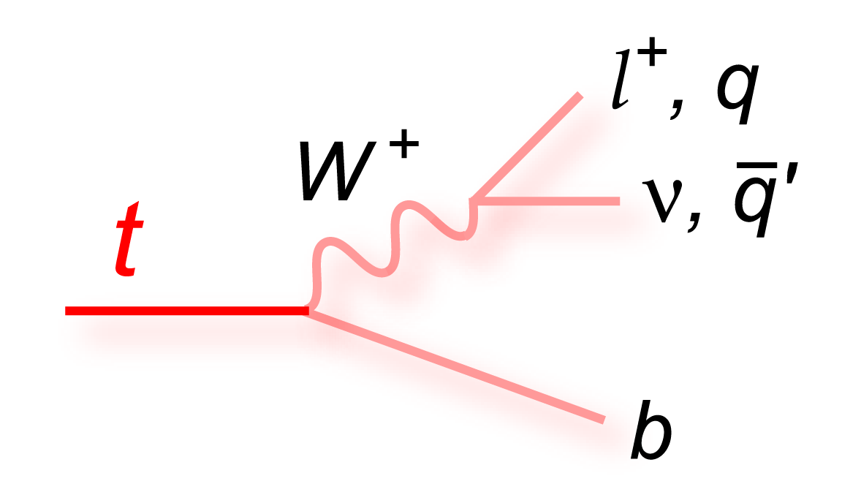
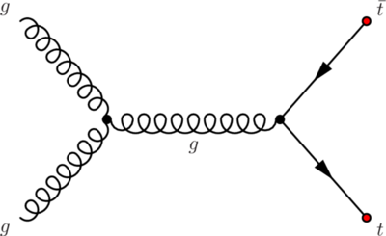
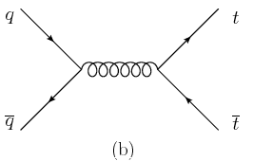
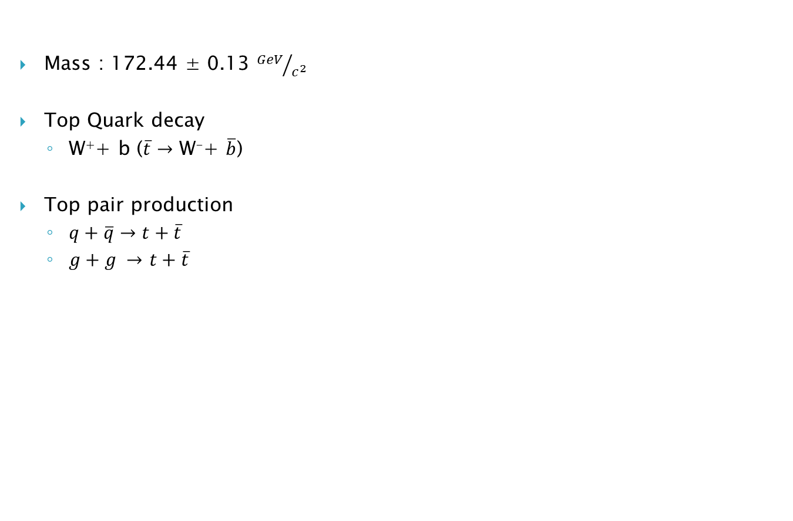
Top Quark
Mass : 172.44 ± 0.13 ${GeV}/{c^{2}}$
Top Quark decay
W⁺+ b ($\overline{t}→$ W⁻+ $\overline{b}$)
Top pair production
$q+\overline{q}→t+\overline{t}$
$g+g →$ $t+\overline{t}$
Gluon Fusion is dominant at LHC

Slide 4
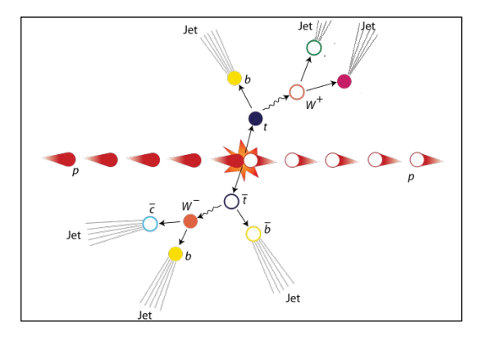
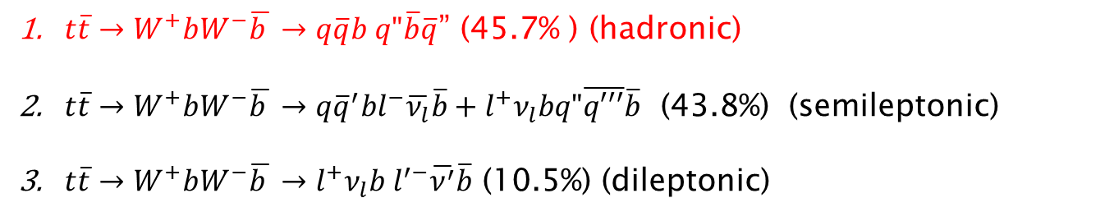
Top AntiTop system decay
$t\overline{t}→W^{+}bW^{−}\overline{b }→q\overline{q}b q"\overline{b}\overline{q}$” (45.7% ) (hadronic)
$t\overline{t}→W^{+}bW^{−}\overline{b }→q{\overline{q}}^{′}bl^{−}\overline{ν_{l}}\overline{b}+l^{+}ν_{l}bq"\overline{q′′′}\overline{b}$ (43.8%) (semileptonic)
$t\overline{t}→W^{+}bW^{−}\overline{b }→l^{+}ν_{l}b l^{′−}\overline{ν^{′}}\overline{b}$ (10.5%) (dileptonic)

Slide 5
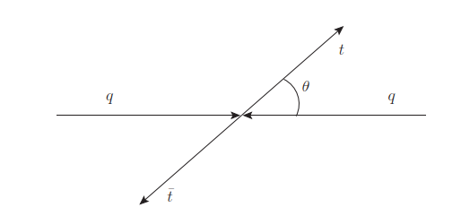


Top Quark Spin Correlation
Top quark decays before hadronization
Spin and polarization of the top quark affects the angular distributions of the decay products
@L0 production the $t\overline{t}$mechanisms are:
$q\overline{q}$
Unlike helicity gg → $g_{L}g_{R}+g_{R}g_{L}$
Like helicity gg → $g_{L}g_{L}+g_{R}g_{R}$
$q\overline{q}$→$t\overline{t}$ where θ opening angle between one of the outgoing t and the incoming q

Slide 6
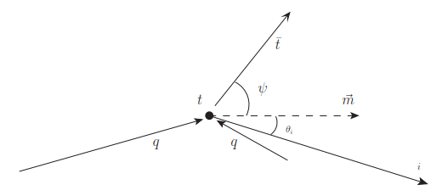

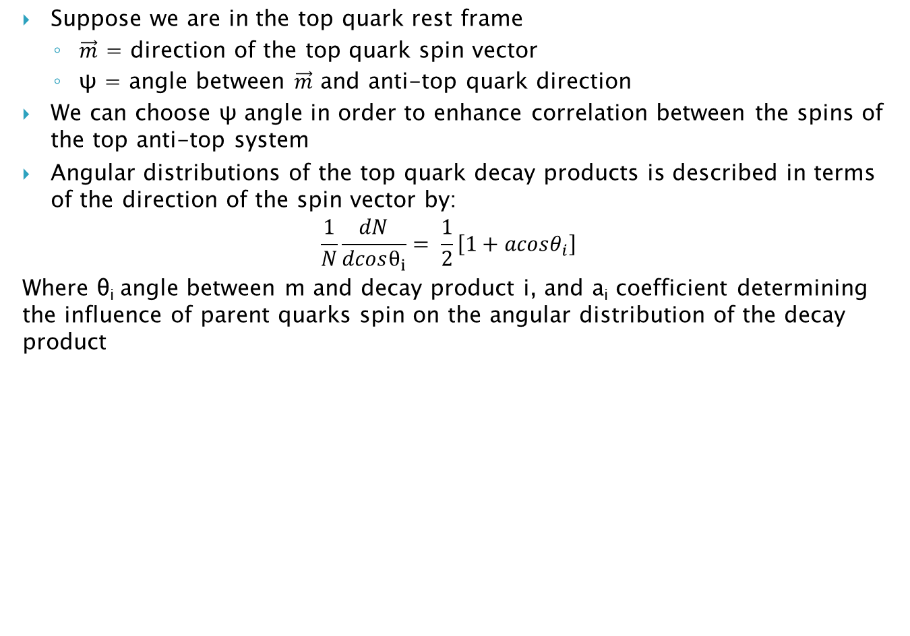
Suppose we are in the top quark rest frame
$\vec{m}$ = direction of the top quark spin vector
ψ = angle between $\vec{m}$ and anti-top quark direction
We can choose ψ angle in order to enhance correlation between the spins of the top anti-top system
Angular distributions of the top quark decay products is described in terms of the direction of the spin vector by:
$$\frac{1}{N}\frac{dN}{dcosθ_{i}}= \frac{1}{2}\left[1+acosθ_{i}\right]$$
Where θ_{i} angle between m and decay product i, and a_{i} coefficient determining the influence of parent quarks spin on the angular distribution of the decay product

Slide 7


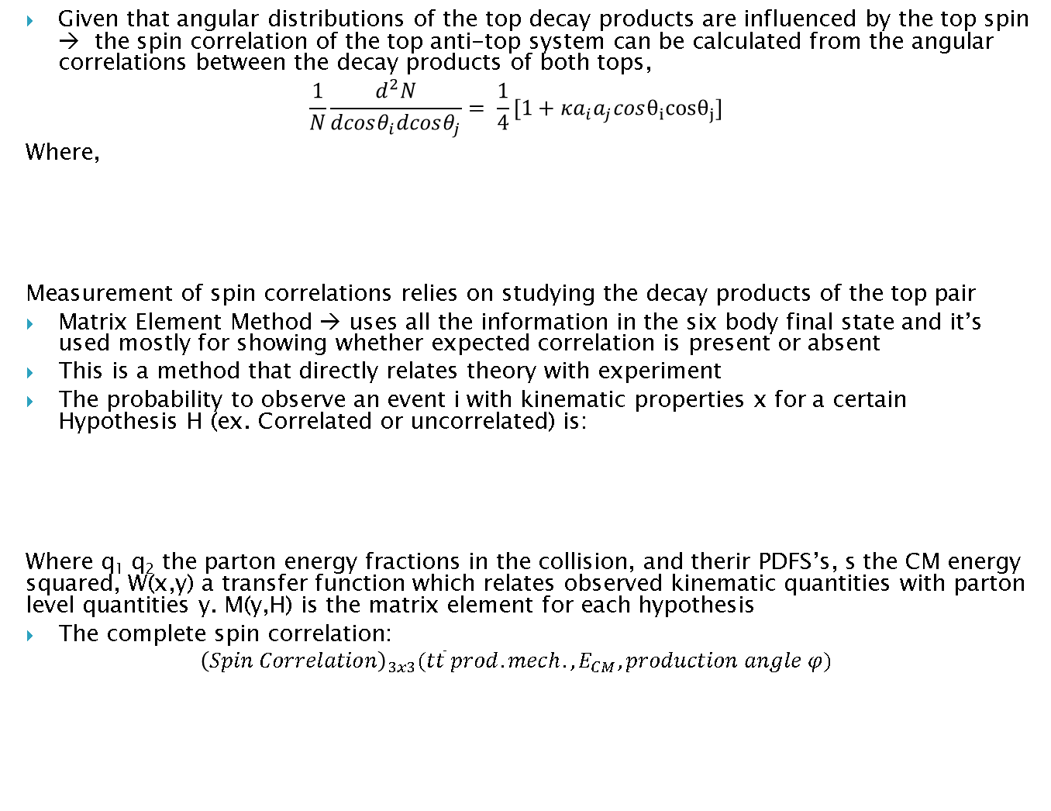
Given that angular distributions of the top decay products are influenced by the top spin → the spin correlation of the top anti-top system can be calculated from the angular correlations between the decay products of both tops,
$$\frac{1}{N}\frac{d^{2}N}{dcosθ_{i}dcosθ_{j}}= \frac{1}{4}[1+κa_{i}a_{j}cosθ_{i}cosθ_{j}]$$
Where,
Measurement of spin correlations relies on studying the decay products of the top pair
Matrix Element Method → uses all the information in the six body final state and it’s used mostly for showing whether expected correlation is present or absent
This is a method that directly relates theory with experiment
The probability to observe an event i with kinematic properties x for a certain Hypothesis H (ex. Correlated or uncorrelated) is:
Where q₁ q₂ the parton energy fractions in the collision, and therir PDFS’s, s the CM energy squared, W(x,y) a transfer function which relates observed kinematic quantities with parton level quantities y. M(y,H) is the matrix element for each hypothesis
The complete spin correlation:
$${\left(Spin Correlation\right)}_{3x3}(t\overline{t} prod. mech., E_{CM},production angle φ)$$

Slide 8

Spin Quantization basis
Top quark spin information → directly accesses by measuring angular distributions of its decay products with respect to a spin vector $≝$ quantization basis
To define a basis
$\vec{m} measures the angle of the top decay products$
$\vec{n} measures the angle of the anti−top decay products$
The choice of the basis affects the amount of observed spin correlation (example: we can choose a basis so that top spins are fully correlated)

Slide 9
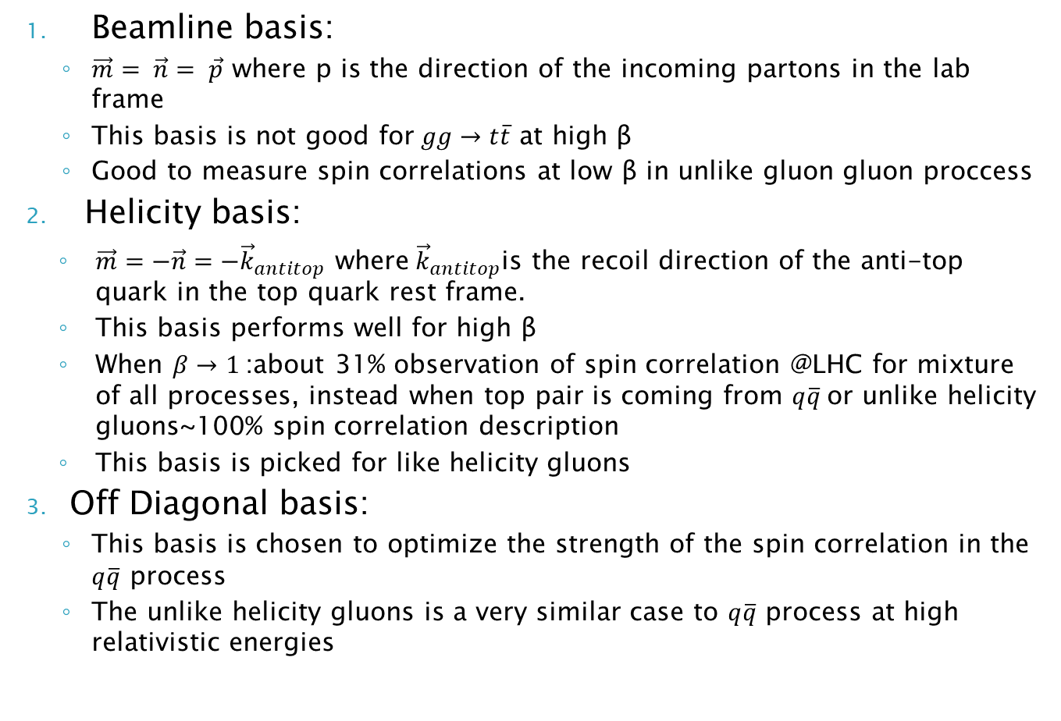
Beamline basis:
$\vec{m}= \vec{n}= \vec{p}$ where p is the direction of the incoming partons in the lab frame
This basis is not good for$gg→t\overline{t}$ at high β
Good to measure spin correlations at low β in unlike gluon gluon proccess
Helicity basis:
$\vec{m}=−\vec{n}=−{\vec{k}}_{antitop}$ where${\vec{k}}_{antitop}$is the recoil direction of the anti-top quark in the top quark rest frame.
This basis performs well for high β
When $β→1$:about 31% observation of spin correlation @LHC for mixture of all processes, instead when top pair is coming from $q\overline{q}$or unlike helicity gluons~100% spin correlation description
This basis is picked for like helicity gluons
Off Diagonal basis:
This basis is chosen to optimize the strength of the spin correlation in the $q\overline{q}$ process
The unlike helicity gluons is a very similar case to $q\overline{q}$ process at high relativistic energies

Slide 10
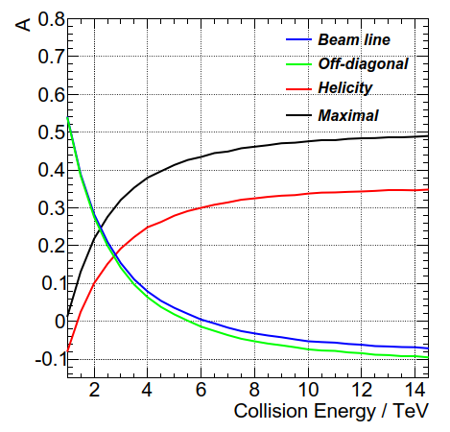
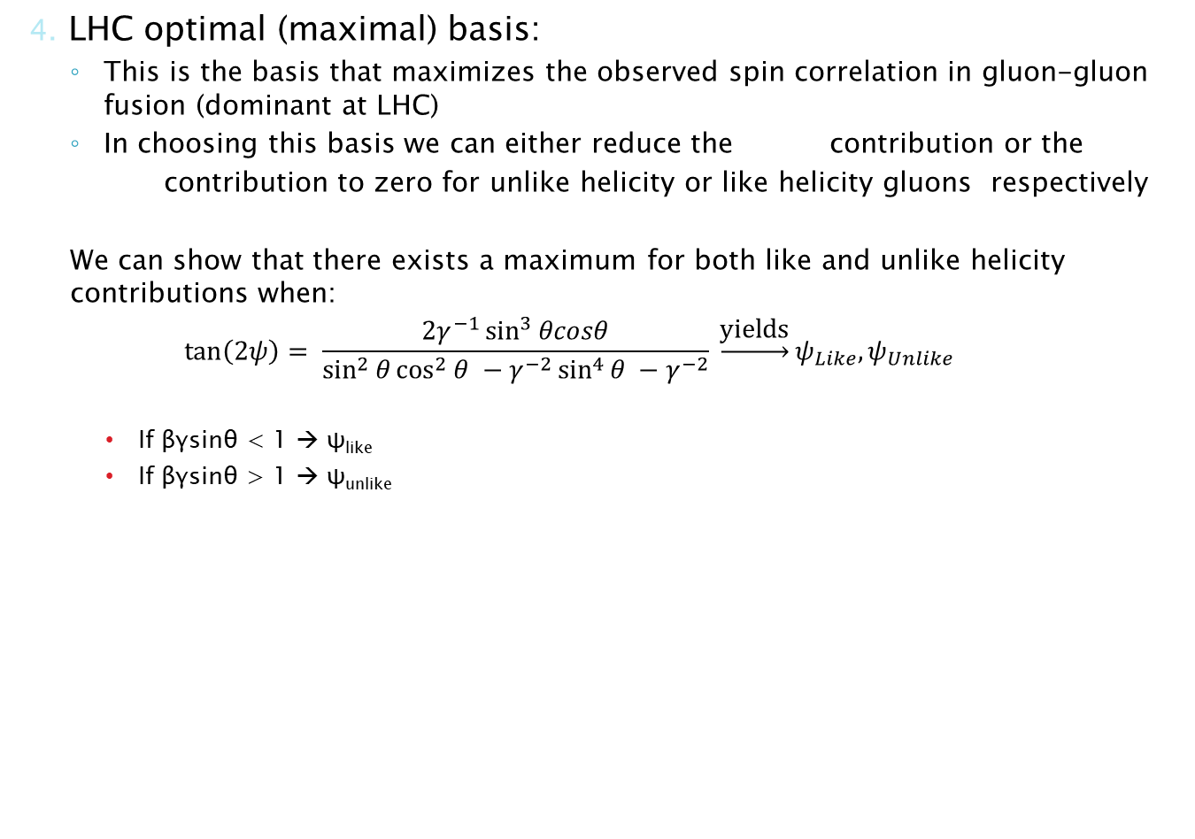
4. LHC optimal (maximal) basis:
This is the basis that maximizes the observed spin correlation in gluon-gluon fusion (dominant at LHC)
In choosing this basis we can either reduce the contribution or the
contribution to zero for unlike helicity or like helicity gluons respectively
We can show that there exists a maximum for both like and unlike helicity contributions when:
$$\tan\left(2ψ\right)= \frac{2γ^{−1}\sin^{3}{θcosθ}}{\sin^{2}{θ\cos^{2}{θ −γ^{−2}\sin^{4}{θ −γ^{−2}}}}} \underset{→}{\text{yields}}ψ_{Like}, ψ_{Unlike}$$
If βγsinθ < 1 → ψ_{like}
If βγsinθ > 1 → ψ_{unlike}
Strength of top anti-top spin correlation for the four bases as a function of the collision energy

Slide 11
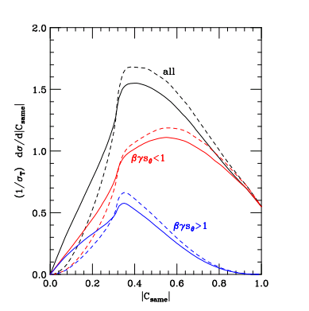
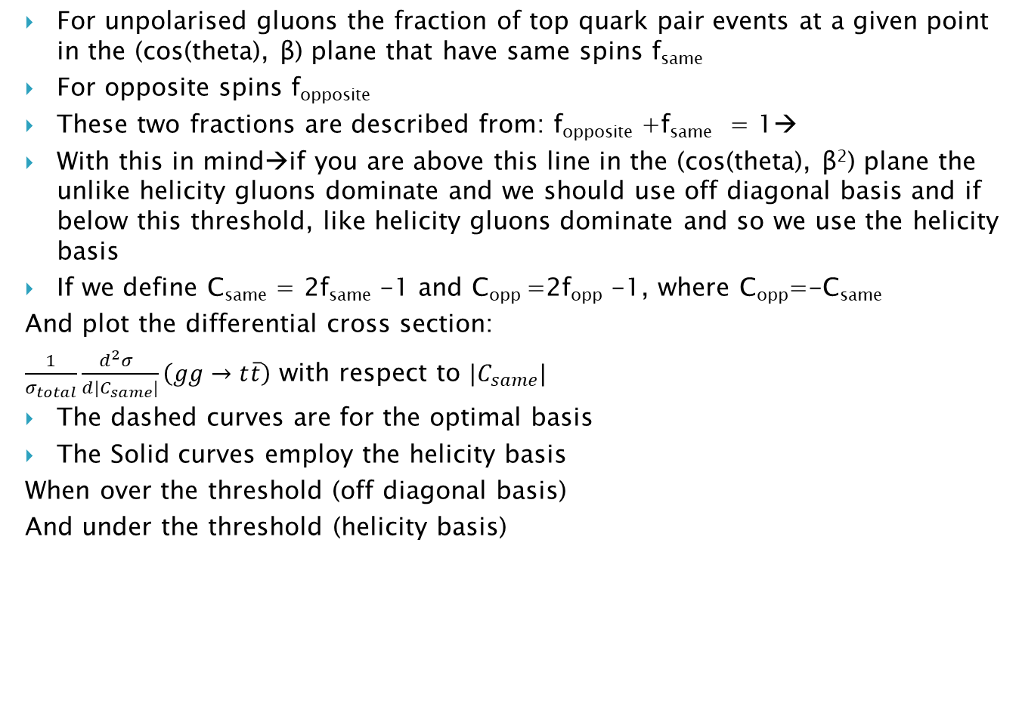
For unpolarised gluons the fraction of top quark pair events at a given point in the (cos(theta), β) plane that have same spins f_{same}
For opposite spins f_{opposite}
These two fractions are described from: f_{opposite} +f_{same} = 1→
With this in mind→if you are above this line in the (cos(theta), β²) plane the unlike helicity gluons dominate and we should use off diagonal basis and if below this threshold, like helicity gluons dominate and so we use the helicity basis
If we define C_{same} = 2f_{same} -1 and C_{opp} =2f_{opp} -1, where C_{opp}=-C_{same}
And plot the differential cross section:
$\frac{1}{σ_{total}}\frac{d^{2}σ }{d|C_{same}|}\left(gg→t\overline{t}\right)$ with respect to $|C_{same}|$
The dashed curves are for the optimal basis
The Solid curves employ the helicity basis
When over the threshold (off diagonal basis)
And under the threshold (helicity basis)

Slide 12
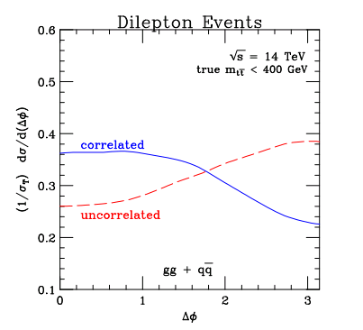
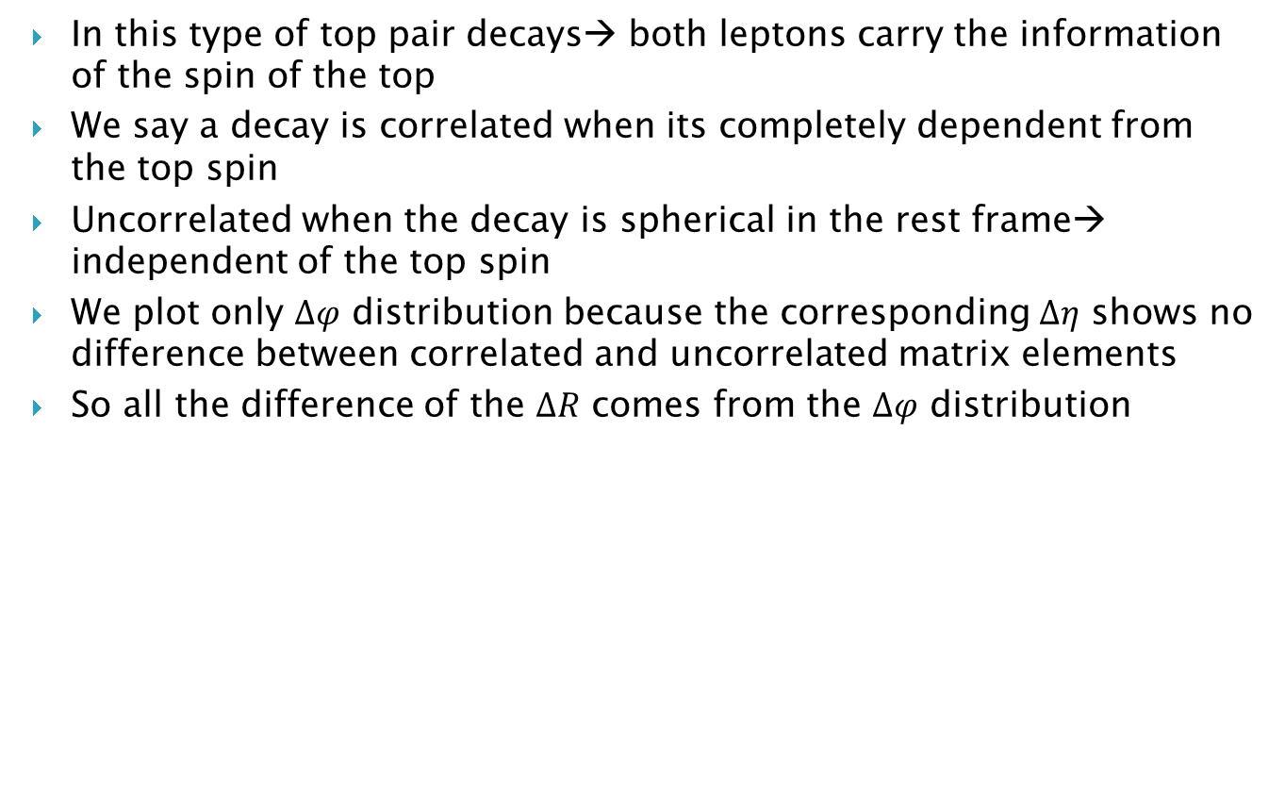
Dilepton Events
In this type of top pair decays→ both leptons carry the information of the spin of the top
We say a decay is correlated when its completely dependent from the top spin
Uncorrelated when the decay is spherical in the rest frame→ independent of the top spin
We plot only $Δφ$ distribution because the corresponding $Δη$ shows no difference between correlated and uncorrelated matrix elements
So all the difference of the $ΔR$ comes from the $Δφ$ distribution

Slide 13
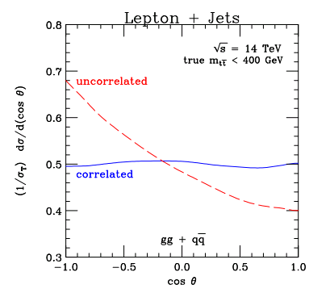

Semileptonic Events
We know that in this channel→ opening angle between lepton and d-quark jet is sensitive to the presence or absence of correlations between production and decay
Definition of the d-quark→ closest jet to the b tagged jet in the W rest frame
Fully correlated top decays show almost flat distribution
Uncorrelated decays→ strong peak near $cosθ=−1$

Slide 14
Plans and goals
1. Does the W four momentum carry top spin information?
2. How much of the information does the b-quark carry if we cannot get information from the W candidate
3. If none of this is viable, switch to leptonic decays in boosted regions

